Slide 1
BloodLink Digital Donor Network using web development technologies

Slide 2
Abstract
Blood donation is an essential practice worldwide, crucial for saving countless lives and supporting the healthcare system. The traditional methodologies employed in managing blood banks, however, are often characterized by inefficiencies and a high potential for errors. These conventional systems, primarily paper-based, struggle with accurate record-keeping, have long waiting times for donors, and face challenges in maintaining optimal blood inventory levels.
To revolutionize this crucial sector, we have developed an innovative web application dedicated to blood bank management. This application is engineered to significantly enhance the efficiency of managing blood bank processes, such as inventory management, donor registration, and the distribution of blood units. By digitizing these processes, our solution aims to reduce the time consumed in manual operations and minimize the risk of errors that are often prevalent in traditional methods.

Slide 3
INTRODUCTION
Blood donation, an integral component of global healthcare systems, plays a pivotal role in saving lives and improving health outcomes.
However, the efficiency of this life-saving practice is heavily dependent on the effectiveness of blood bank management systems.
Traditionally, these systems have been bogged down by time-consuming, paper-based processes, leading to several challenges.
Among these are inaccuracies in record-keeping, prolonged waiting periods for donors, and inefficient management of blood inventories.

Slide 4
The need for a contemporary, streamlined blood bank management system is underscored by the criticality of safe blood in healthcare.
In India, the demand for blood illustrates a concerning scenario. With a requirement of approximately 15 million units of blood annually, the country faces a deficit of about 4 million units. This shortfall has dire consequences, contributing to a high rate of preventable deaths.
The urgency is highlighted by statistics showing that every two seconds, someone in India needs blood, and the daily mortality rate due to lack of blood availability is alarmingly high.

Slide 5
LITERATURE SURVEY
In The First Study research, in the title of a web-based blood donation Network under the research of John Smith in the university of California , Berkeley . In the Second Study research, in the title of Design and Implementation of a Digital Blood Donor Network under the research of Emily Johnson in the university of Stanford. In the Third research, in the title of Digital Network; A Systematic Review of Web-Based Blood Donation Platform under the research of Fatima Ahmed in the university of Oxford University . In the Third research, in the title of Designing an Efficient Blood Donation Network using Web Technologies under the research of Priya Patel in the university IIT(Bombay) in this all project there is network between donor, patient, hospital.
This concept aligns with the proposed ‘Bloodlink system', which aims to integrate distributed master identity records and provide authorized access to user profiles.
BloodLink Digital Donor Network using web development technologies application illustrate the effectiveness of communication in facilitating blood donation.

Slide 6
Technology Used
Category | Technology
Frontend Framework | React.js
Frontend Languages | JavaScript, HTML5, CSS3
State Management | Redux
Backend Runtime Environment | Node.js
Backend Framework | Express.js
Authentication | JSON Web Token (JWT)
Database | MongoDB
ODM | Mongoose
Version Control | Git
Code Editor | Visual Studio Code
Package Manager | npm

Slide 7
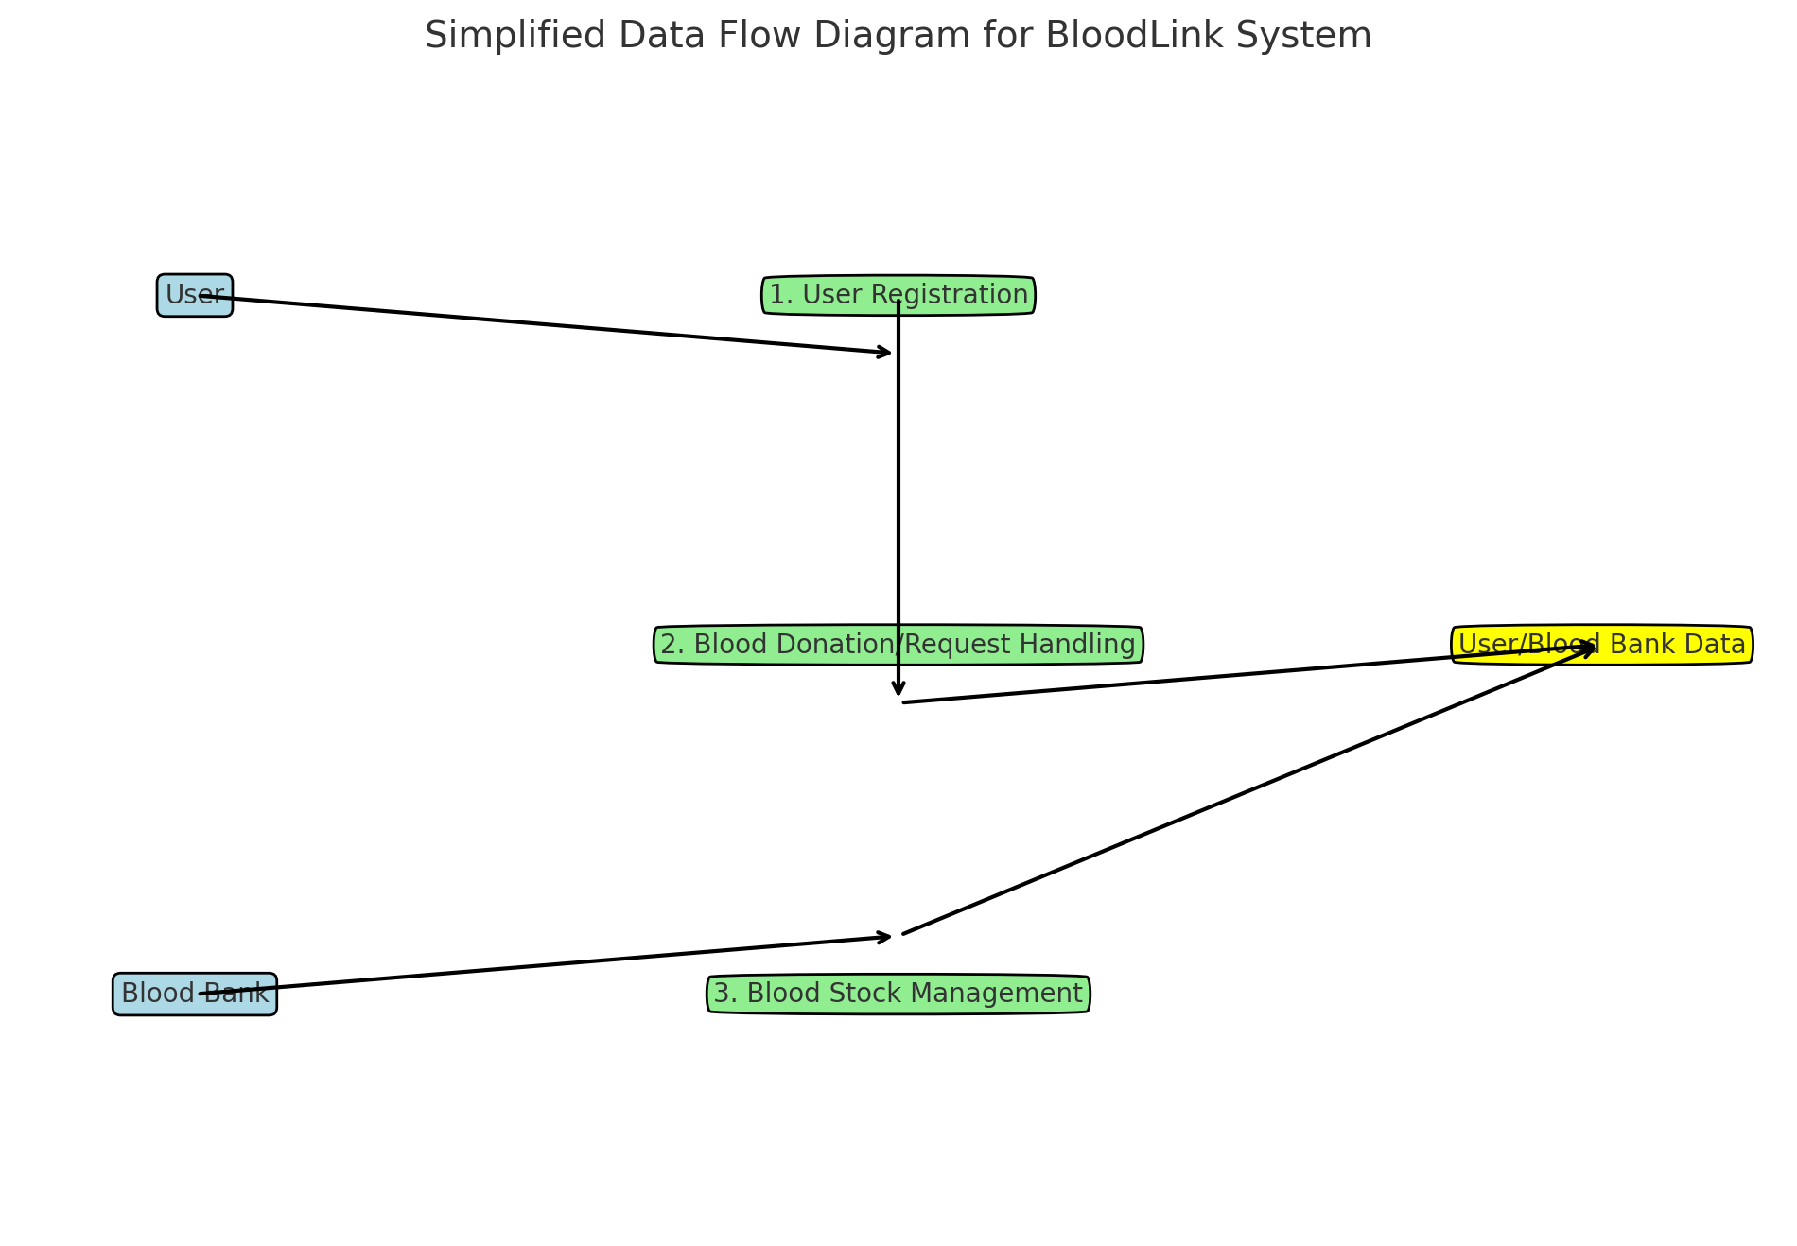
Data Flow Diagram

Slide 8
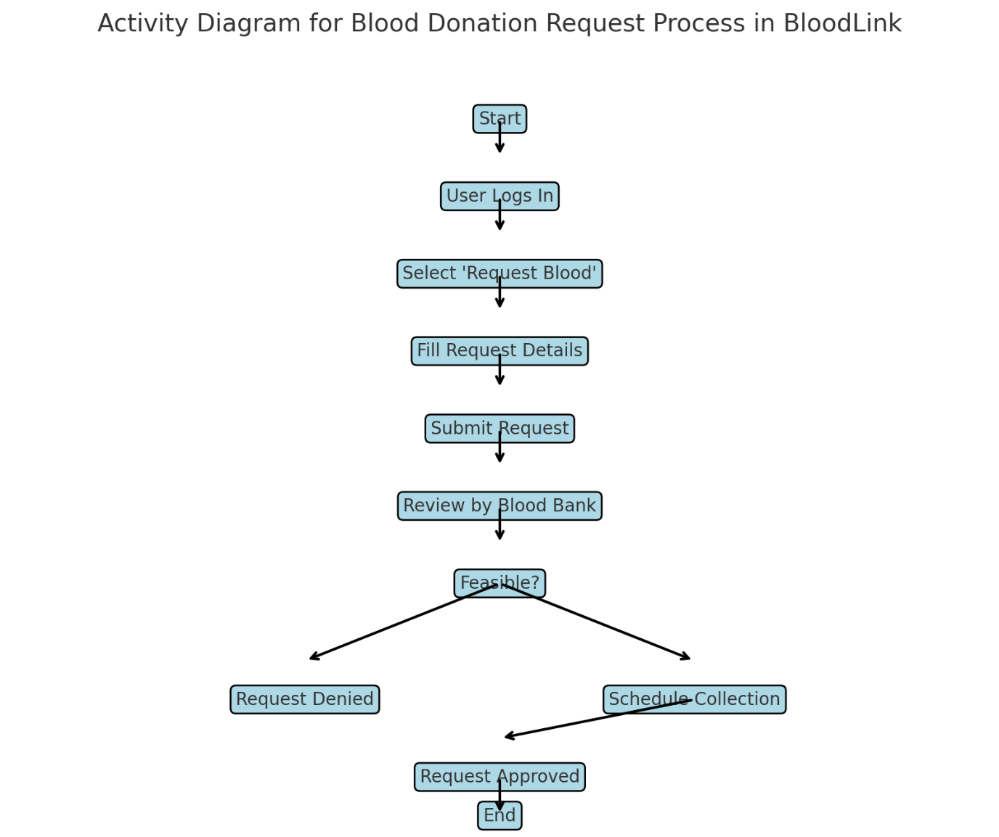
Activity Diagram

Slide 9
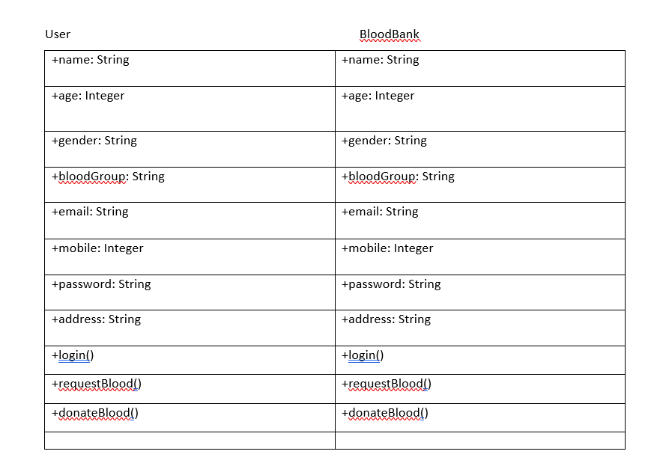
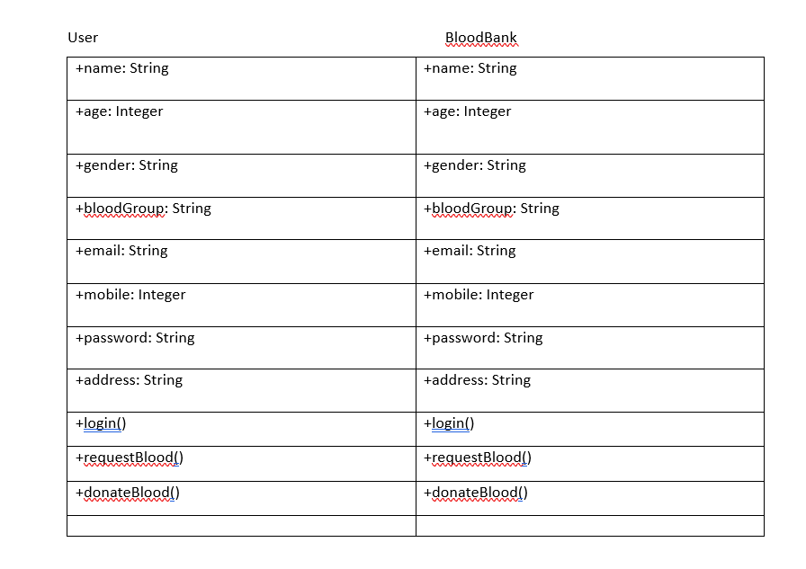
UML Diagram

Slide 10
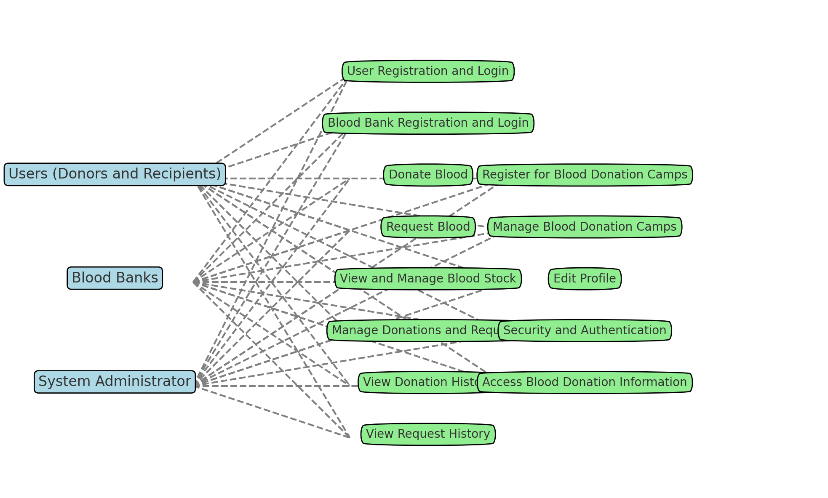
Use Case Diagram

Slide 11
Data Flow Diagram
The DFD for BloodLink demonstrates how data is processed and flows through the system. It includes entities like 'User' and 'Blood Bank', processes such as 'User Registration/Login', 'Donation/Request Handling', 'Blood Match & Availability', and data stores like 'User/Blood Bank Data'. Arrows show the direction of data flow, reflecting interactions like users registering or logging in, their data being processed and stored, and how this data is then used for donation/request handling and matching.
The Activity Diagram for BloodLink maps out the process of handling a blood donation request. Starting from the user login, it leads through steps like selecting to request blood, filling out details, submitting the request, and the subsequent review by the blood bank. The diagram shows decision points (like the feasibility of a request), resulting in different outcomes (approval or denial), and then concludes with user notification.
Activity Diagram

Slide 12
UML Diagram
For BloodLink, the UML Diagram (likely a Class Diagram) would depict various classes like 'User', 'BloodBank', 'Donation', 'Request', and 'BloodDonationCamp'. Each class would have its attributes (like name, age, gender for a User) and methods (like login, register, donateBlood). Relationships between these classes are also shown, for instance, a User may make multiple Donations, or a BloodBank may handle many Requests.
The Use Case Diagram for BloodLink would visually represent the interactions between the system and its users (both donors and recipients), and other external entities like Blood Banks. It would include use cases like 'Register as a User', 'Donate Blood', 'Request Blood', 'Manage Blood Stock', etc. This diagram helps in understanding the functionalities the system offers and how different actors interact with these functionalities.
Use Case Diagram

Slide 13
EXISTING SYSTEM
The existing system may consist of a more traditional or less integrated approach, possibly with the following characteristics:
User Interaction: Manual processes for registration and request handling, such as physical forms or basic web forms without real-time feedback.
Data Management: Data could be stored in isolated databases or even in non-digital formats, leading to slower retrieval and processing times.
Communication: Communication between users and blood banks might rely on phone calls, emails, or physical mail.
Integration: Limited integration with external systems, meaning processes like verifying donor eligibility or health status might be more manual.
Security: Basic security measures, potentially lacking sophisticated encryption or access control systems.

Slide 14
PROPOSED SYSTEM
User Interface Layer: Interactive web and mobile interfaces allowing users to quickly register, Blood Donations camps request donations, and receive updates.
Business Logic Layer: A set of microservices handling specific tasks, ensuring scalability and easier maintenance.
Data Access Layer: Middleware offering a secure and standardized way to access and manipulate data across the system.
Database Layer: A centralized, possibly cloud-based database system that efficiently stores and manages all the data in a structured way.
External Interfaces: API integrations with health systems for instant verification, notification systems for alerts, and possibly analytics services for data insights.
Security Layer: Advanced security measures including encryption, secure API access, and compliance with healthcare data protection standards.

Slide 15
IMPLEMENTATION
Here’s how we implement the BloodLink system using the MERN stack:
Front-end (React):
Develop user interfaces for both donors and recipients with React, taking advantage of its component-based architecture to handle the state and presentation of user, donation, and request data.
Use React Router for client-side routing to different parts of the application, such as user registration, blood donation forms, and blood requests.
Back-end (Node.js and Express.js):
Implement server-side logic using Node.js with an Express.js framework to create RESTful API endpoints for handling business logic like user authentication, donation processing, and matching blood requests with available stocks.
Implement middleware for error handling, request logging, and other cross-cutting concerns.

Slide 16
IMPLEMENTATION
Data Access Layer:
Use Mongoose, an Object Data Modeling (ODM) library for MongoDB and Node.js, to interact with the MongoDB database. Mongoose provides a schema-based solution to model your application data.
Create models for users, donations, blood banks, and requests to define the structure of the data and validate it before saving it to the database.
Database (MongoDB):
Store data in MongoDB, a NoSQL database, which allows for flexible data representation. This is particularly beneficial for the BloodLink system as it might have to handle diverse and complex data structures.
Design the database schema to store user profiles, donation records, requests, and blood bank information.

Slide 17
IMPLEMENTATION
External Interfaces:
Integrate with third-party services like SMS or email for notifications using appropriate APIs.
Connect with external healthcare APIs for additional functionalities, such as verifying donor eligibility or integrating with hospital systems.
Security:
Implement authentication using JSON Web Tokens (JWT) to maintain secure sessions.
Ensure data validation both on the client and server sides to prevent injections and other attacks.
Use HTTPS to encrypt data in transit and, if necessary, at rest.

Slide 18
IMPLEMENTATION
Deployment:
Local Host
Proposed System Architecture Overview:
Front-End Layer (React.js): User Interfaces for Donors and Recipients.
Web Server Layer (Node.js + Express.js): RESTful API Endpoints.
Business Logic Layer (Node.js): Processing and Business Rules.
Data Access Layer (Mongoose): Database Operations.
Database Layer (MongoDB): Data Persistence.
Security: Authentication, Authorization, and Data Validation.

Slide 19
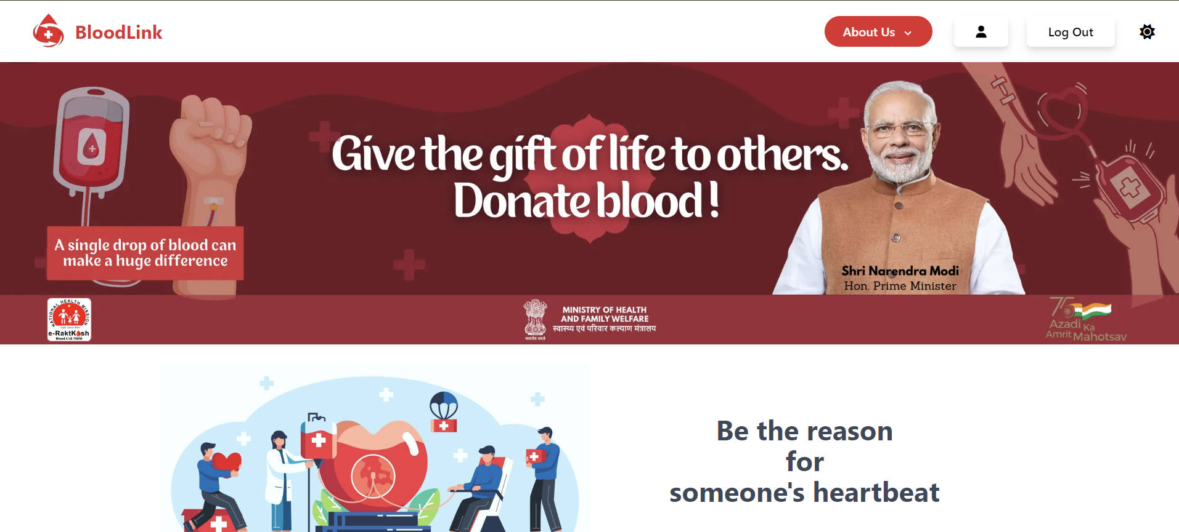
SCREEN SHOT(Home Page)

Slide 20
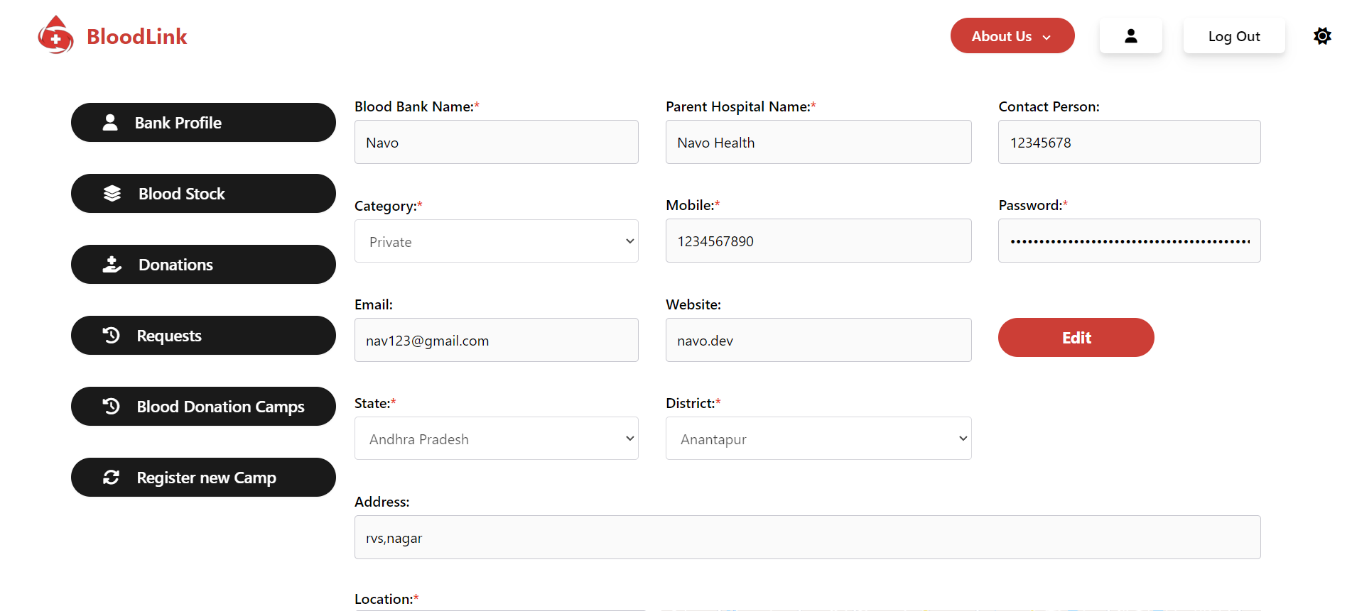
SCREEN SHOT(Hospital Page)

Slide 21
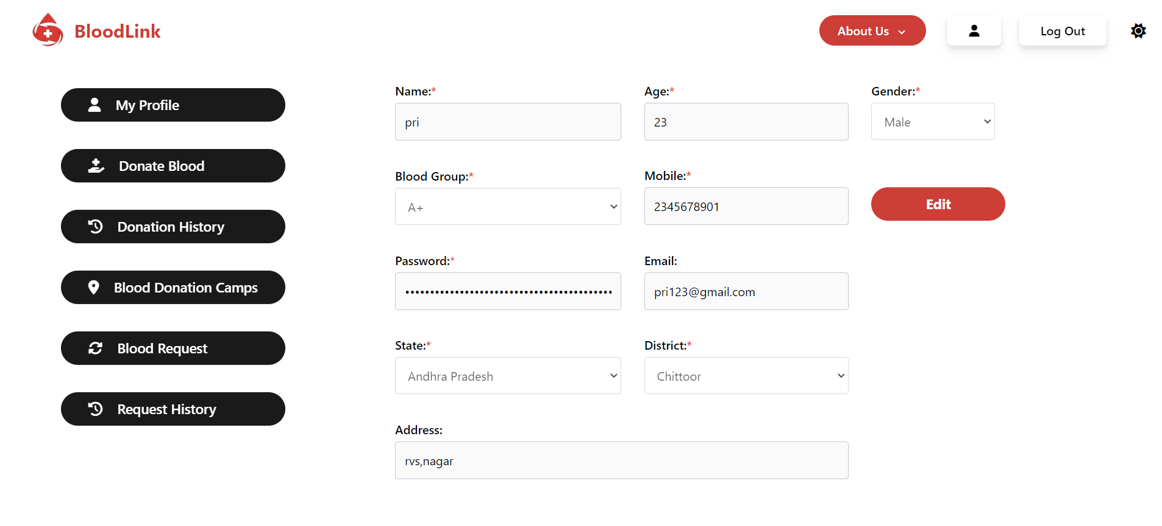
SCREEN SHOT(Patient Page)

Slide 22
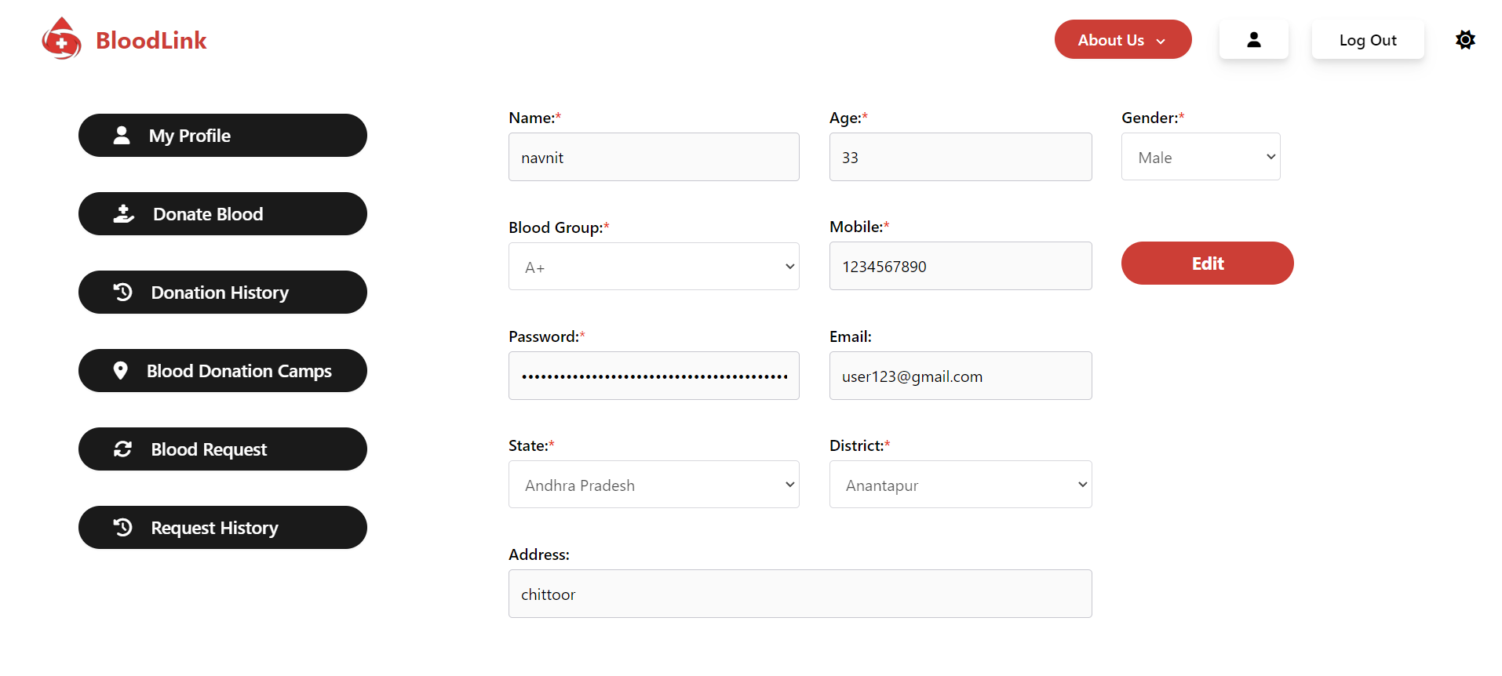
SCREEN SHOT(Patient Page)

Slide 23
RESULT
The time taken to find a donor through the system differs between the current process and the proposed process. In the proposed system, automated blood group matching identifies the best-match.
The application is also designed to locate the best matches among accessible donors with the assistance of an automation algorithm.
The Patient get there blood matching blood group as soon as possible from there nearest hospital.
The Donor can donate there blood very easily and the patient get matching blood easily.
Additionally, the system ensures separate account logins for blood donors , recipients, regular users and hospital.

Slide 24
FUTURE SCOPE
Expansion to Organ Donation: While the proposed system focuses on blood donation, there is potential for expansion to include organ donation as well. By leveraging similar blockchain-based secure systems, organ donation records and transplantation processes can be made more transparent and efficient. Future research could explore integrating organ donation functionalities into the existing platform to address the challenges in organ transplantation.
Enhanced User Engagement and Education: The automated questionnaires sent to registered users provide valuable insights into awareness and concerns about blood donation. Future iterations of the system could focus on enhancing user engagement and education through personalized feedback, educational materials, and gasification elements. This can help increase awareness about the importance of blood donation and encourage more people to participate in the donation process.

Slide 25
FUTURE SCOPE
Extended API Ecosystem:
Develop a robust API ecosystem that allows third-party developers to create apps and services that complement the BloodLink platform, such as appointment scheduling or donor rewards programs
Global Expansion and Standardization: While the initial focus is on the Indian healthcare sector, there is potential for global expansion and standardization of the proposed system. Collaborations with international organizations and adoption of common standards for blood donation and transplantation can facilitate interoperability between different regions, leading to more efficient utilization of resources and better outcomes for patients worldwide.

Slide 26
CONCLUSION
No one should die due to a lack of blood .
Currently, there are no artificial replacements for blood or human organs.
This system can play a significant role in advancing blood donation, addressing the considerable problem faced by donors and recipients.
The system's utilization of advanced technology and tracking introduces advanced features not previously available in existing systems.
An exclusive feature of the ‘Bloodlink' application is its ability to seamlessly share data among various blood banks connected to both general and private hospitals, thereby enhancing coordination and efficiency in the donation process.
This transition from existing procedures to a user-friendly, secure, and intelligent system has the potential to alleviate discrepancies and malpractices.
Currently, no specific systems tailored for this purpose are in place in the Indian healthcare sector.

Slide 27
REFERENCE
Edirisinghe, L. (2020). Annual Report - 2018.
Tykn, Identity Management with donation: The Definitive Guide
Perera, L. (2020). Veins: A Lifesaver In The Making
Mathew, R. (2020). Blood donation Decentralized Application Using Blockchain Technology
Pacheco, D. (2020). Characterizing Blood donation Awareness from Social Media
Alandjani, G. (2020). Auditable medical transaction scheme for organ transplant services.
Xiaochu, Y. (2014). Population-based projections of blood supply and demand, China, 2017–2036.

Slide 28
Thank You

